Slide 1
First, Do No Harm
Intra-operative mechanical ventilation for survival
EO O’Brien, MD
Department of Anesthesia, UCSD

Slide 2
European Definition

Slide 3
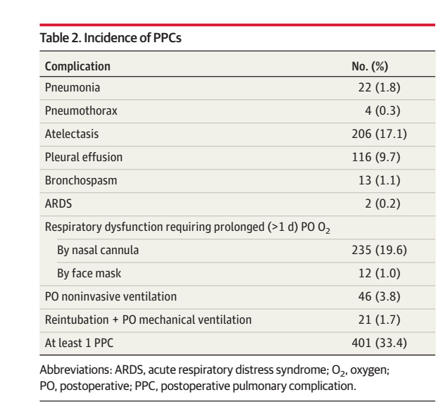
Very Common
Incidents of PPCs is anywhere from 6-6% - 80%. (out of 230 million surgeries worldwide).
Incidence varies with definition
More common than cardiac complications.
Most common is respiratory failure.
JAMA Surg. 2017;152(2):157-166. doi:10.1001/jamasurg.2016.4065

Slide 4
Morbidity and Mortality
Prolongs hospital LOS by 13-17 days.
41-47% increase in cost.
14-30% will die within 30 days of diagnosis compared to 0.2-3% who don’t get PPCs.
24.4% mortality at 90d year compared with 1.2% for patients who don’t get PPCs.
45.9 % mortality at 1 year compared with 8% for those that don’t get PPCs.

Slide 5
Pathophysiology of PPCs
Immediately after induction central respiratory drive is depressed.
Ventilatory response to hypercapnia and hypoxemia is impaired.
Respiratory muscle function dramatically declines. Can lead to airway obstruction, cephalad displacement of the diaphragm and reduced chest wall area. This leads to reduced FRC.
Atelectasis is universal and V/Q matching is altered with some areas of high V/Q and other areas of low V/Q. You get increased dead-space (impaired CO2 excretion) as well as increased V/Q mismatch (hypoxemia)

Slide 6
Pathophysiology of PPCs: Atelectasis
Dependent in most patients who receive NMBAs.
Caused by displaced diaphragm, rapid absorption of gas from alveoli in hypoventilated lung regions.
High FiO2 worsens atelectasis.

Slide 7
Pathophysiology of PPCs: Post Op
Post extubation airway obstruction is common.
Poor coordination of upper airway muscle groups.
Ongoing sedation from residual anesthetic drugs and opiate.
Residual effect of NMBAs.
Impairment of ventilatory response to hypercapnia
Persistent atelectasis, up to 24 hours (more common in obese)
Reduced FRC persists for 1-2 days and recovers by day 5-7.
Impairment of the mucociliary transport.

Slide 8
Non-Modifiable Risk Factors
Age 60 – 69 years (RR 2.1)
Age 70-79 (RR 3.1)
Age >80 (RR 5.1.)
Type of Surgery
AAA repair
Thoracic
Upper abdominal
Major vascular surgery
Neurosurgery
Emergency surgery
Lap vs. open surgery
Pre Op SpO2

Slide 9
Modifiable Risk Factors
COPD
CHF
Chronic Liver Disease
OSA
Smoking
Pre-Op Anemia

Slide 10
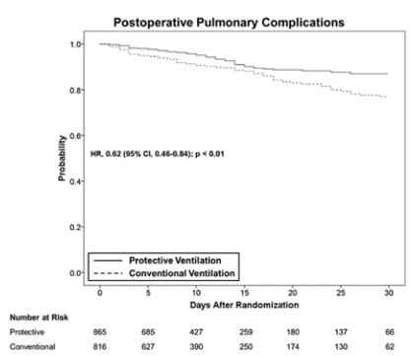
Lung protective ventilation: Low tidal volume
In 2015 meta-analysis risk of PPCs with protective ventilation was 0.64 (0.46-0.88) compared to conventional ventilation.

Slide 11
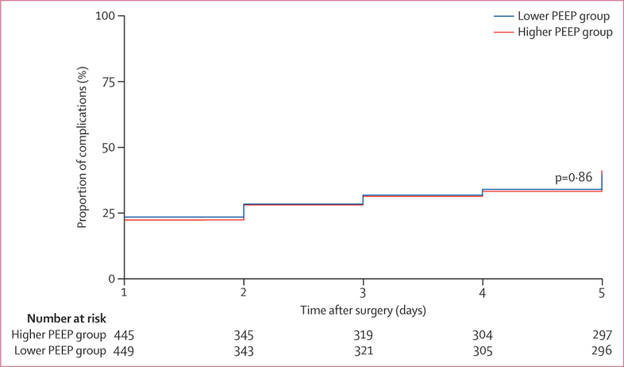
Lung Protective Ventilation: PEEP
Moderate PEEP(≥ 5 cmH2O) with protective ventilation probably protects against PPCs.
High PEEP is more controversial. Doesn’t seem to be much better than moderate PEEP levels but has more hemodynamic compromise.
Higher levels of CC-6, a lung distention biomarker were seen in the high PEEP cohort.

Slide 12
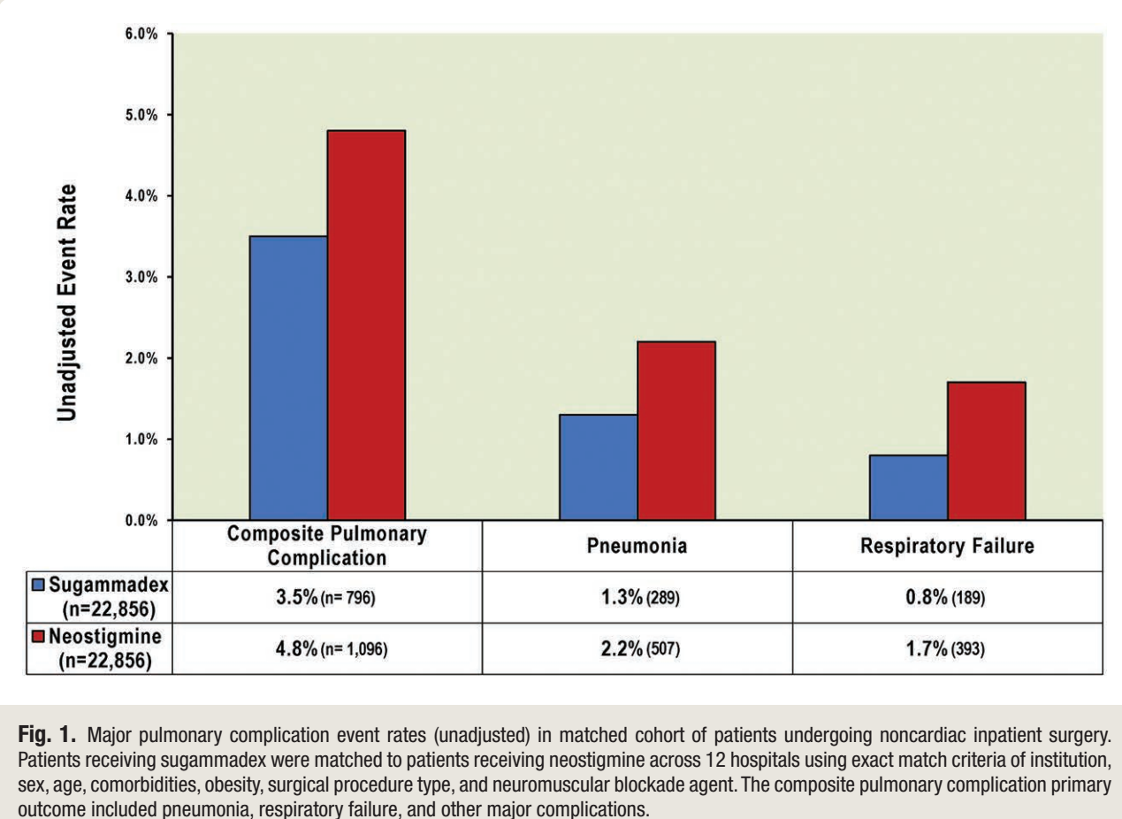
NMBAs and their reversal
Use of NMBA increases incidence of PPCs.
Incidence of PPCs is higher among patients with NMBAs for several days after surgery despite pharmacokinetics suggesting drugs should be cleared.
Appropriate reversal can mitigate this risk.
Sugammadex has fewer PPCs than Neostigmine with about the same rate of complications.

Slide 13
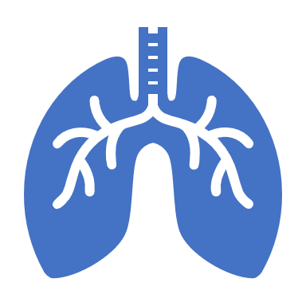
Nasogastric Tubes
Placed to speed return of gut function, decompress the bowel, reduce aspiration risk, and take pressure of anastomoses.
NG tube use has been associated with 5-8-fold increase in risk of PPC.
Not beneficial for elective or emergent surgery.

Slide 14
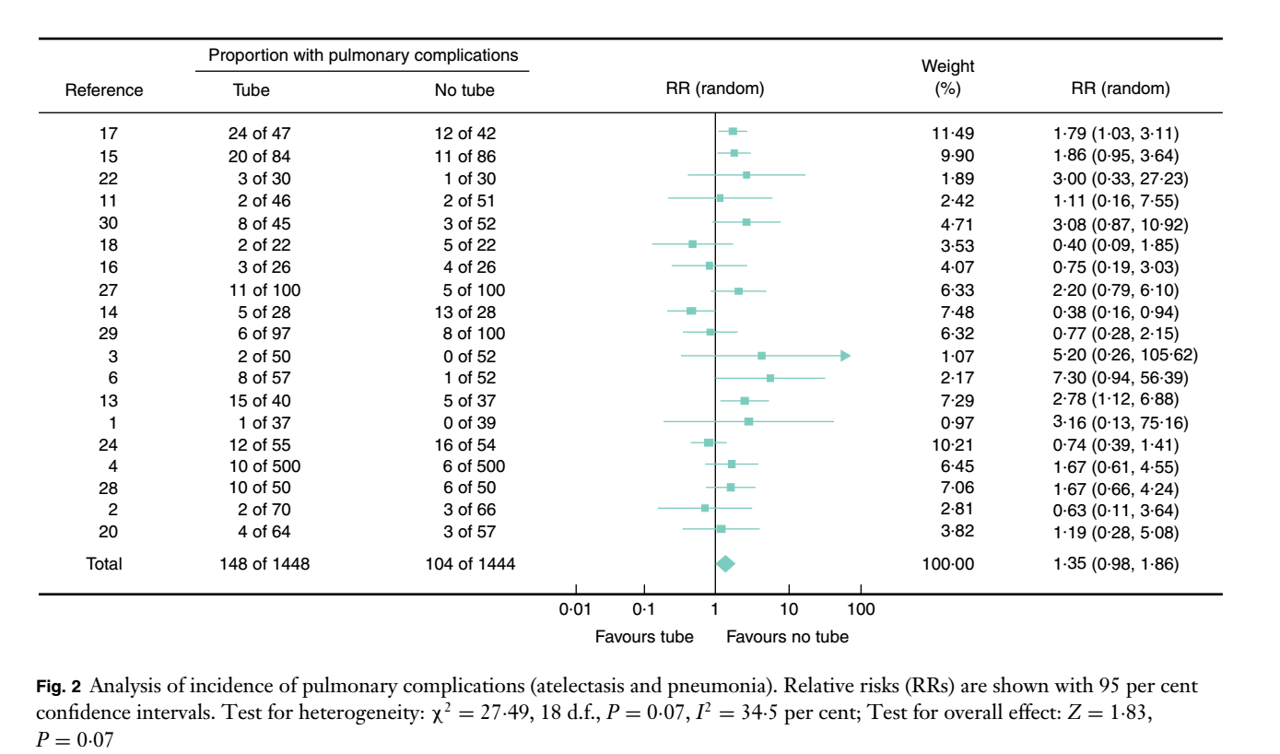
Post-operative pulmonary complications

Slide 15
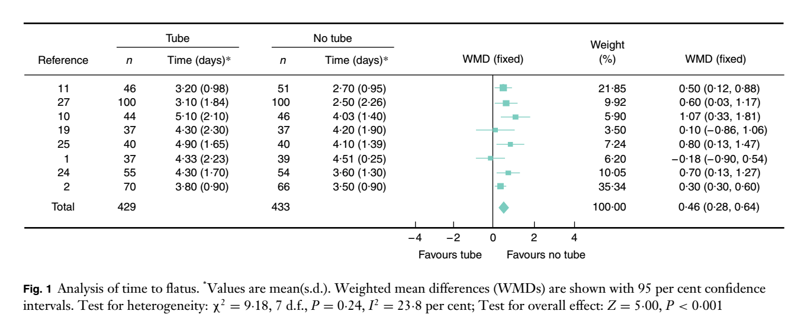
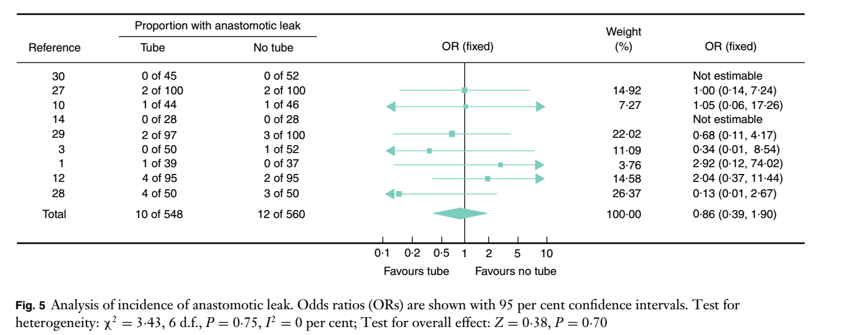
Gut recovery
Anastomotic Leak

Slide 16
Epidural Analgesia
Reduces rates of post-operative pneumonia, requirement for post-op ventilation, and re-intubation.
Highly effective for patients with COPD who get abdominal surgery.
Optimizes diaphragmatic excursion and reduces opiate use.
Highly effective for patients with OSA due to decreased post-operative opiate requirement.

Slide 17
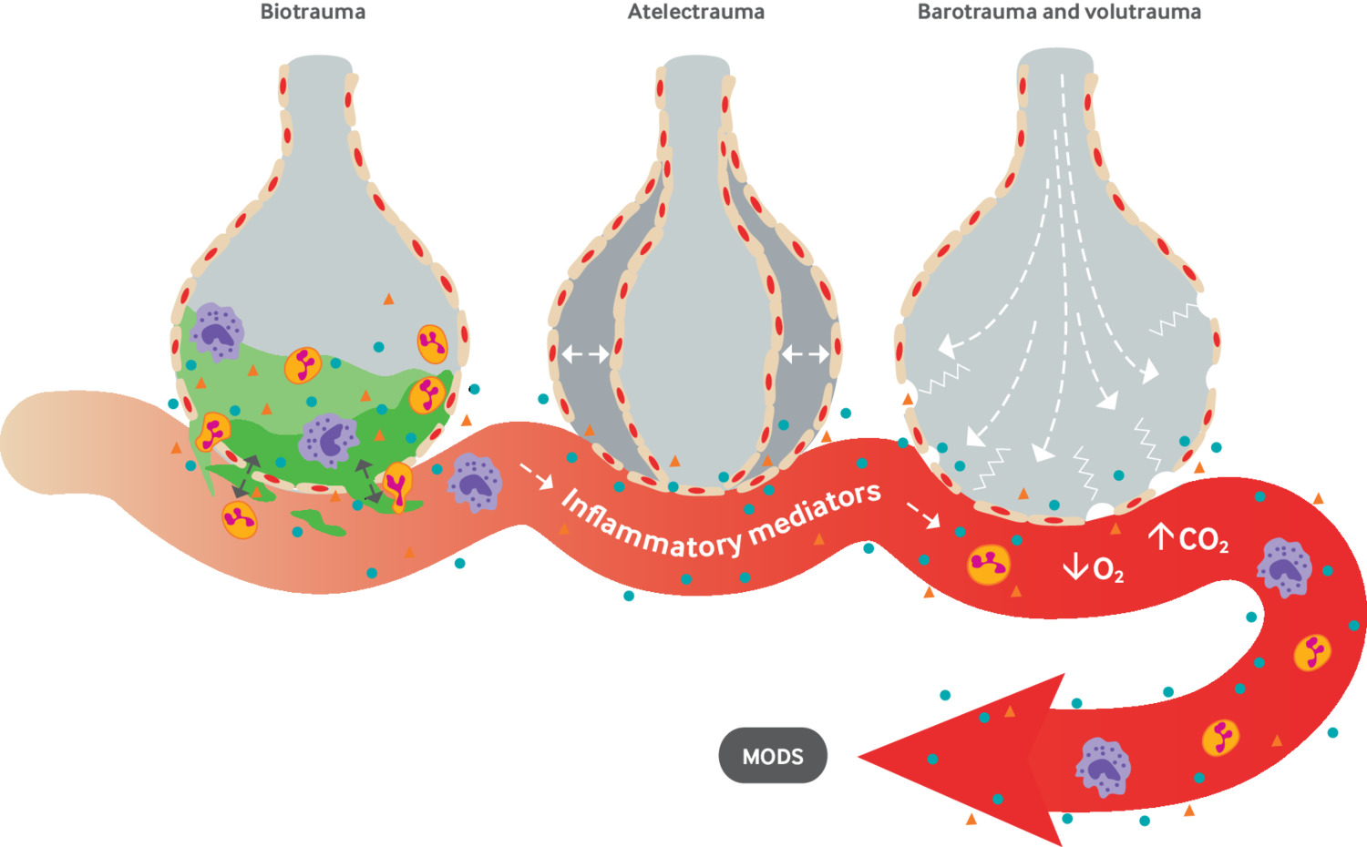
Beyond protective ventilation: Lung stress
Protecting the lung from what?
Definition of lung stress is the global and regional mechanical stress (pressure applied to the lung).
Volu-trauma: Overdistention with excessive V_{t}
Barotrauma: Overdistention with excess plateau pressure (P_{plat)}
Repetitive tidal opening and collapse (atelectrauma)

Slide 18
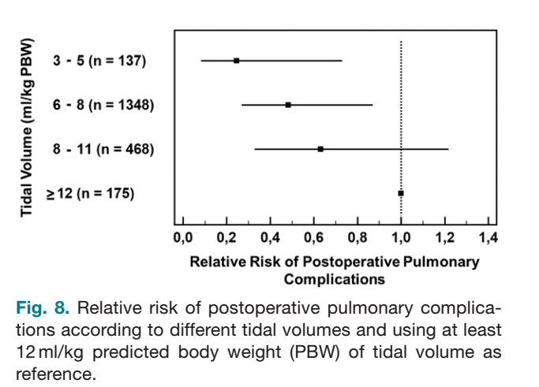
Intra-Operative Ventilation Matters
E. Fernandez-Perez, et. al. Intraoperative Tidal Volume as a Risk Factor for
Respiratory Failure after Pneumonectomy Anesthesiology 2006
Anesthesiology 2015; 123:66-78

Slide 19
Measurements from OR ventilators
Vt →Very easy to get.
PEEP → Very easy to set.
PIP or Peak airway (inspiratory) pressure → very easy to get.
Plateau pressure (P_{plat}) → requires some work.
Driving pressure (airway or respiratory system) ( ΔP_{aw} or ΔP_{rs} ) →requires some work.
Transpulmonary pressure → possible but really impossible.

Slide 20
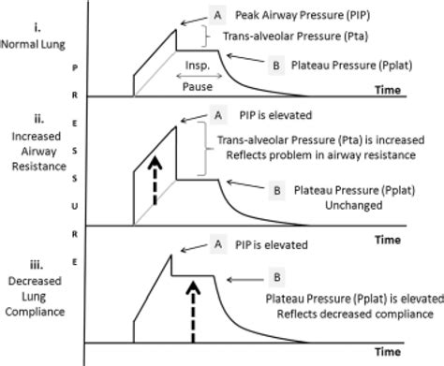
Getting P_{plat} in the OR
Measured at end-inspiration.
Requires an end-inspiratory pause which can be performed with most modern OR ventilators.
It is a static pressure. Associated with no moving air.
Reflects the compliance of the whole respiratory system (lungs and chest wall).
Will vary based on patient position (prone vs. supine)
Will vary based intra-abdominal pressure (e.g. insufflation during laparoscopy)
Will vary if abdomen is open or closed.

Slide 21
Is 6-8 mL/kg always protective?
Obese patient getting laparoscopic surgery in Trendelenburg position.
Heterogeneous “open” lung (e.g. areas of atelectasis adjacent to areas of over distention).
Cyclic opening and closing of alveoli.
Areas of baro- and volu- trauma co-exist with atelectatic segments.
Hypoventilation, acidosis and requirement for NMBAs.
Non-obese patient getting open abdominal surgery with titrated PEEP.
Ventilation strategy of 6-8 mL/kg with Pplat < 13-15 cmH2O is probably protective.

Slide 22
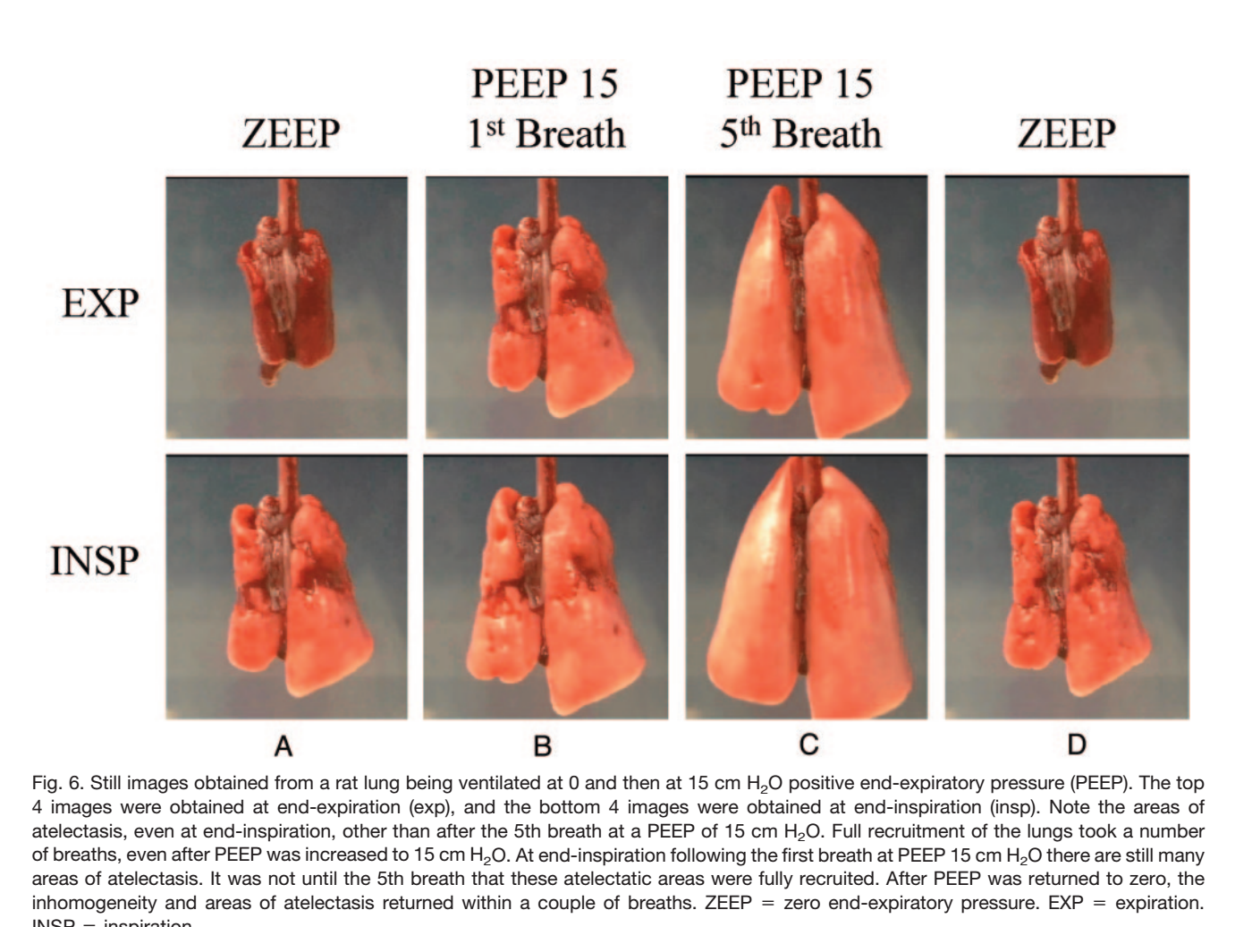
PEEP: Friend, Enemy or “Frenemy”?
Intended to keep alveoli and small airways open at end-expiration.
Recruit otherwise closed segments of lung and keep lung homogeneous (fewer adjacent open and closed regions)
Prevent repetitive atelecto-trauma (opening-closing)
Improve lymphatic drainage of alveolar and interstitial lung regions.

Slide 23
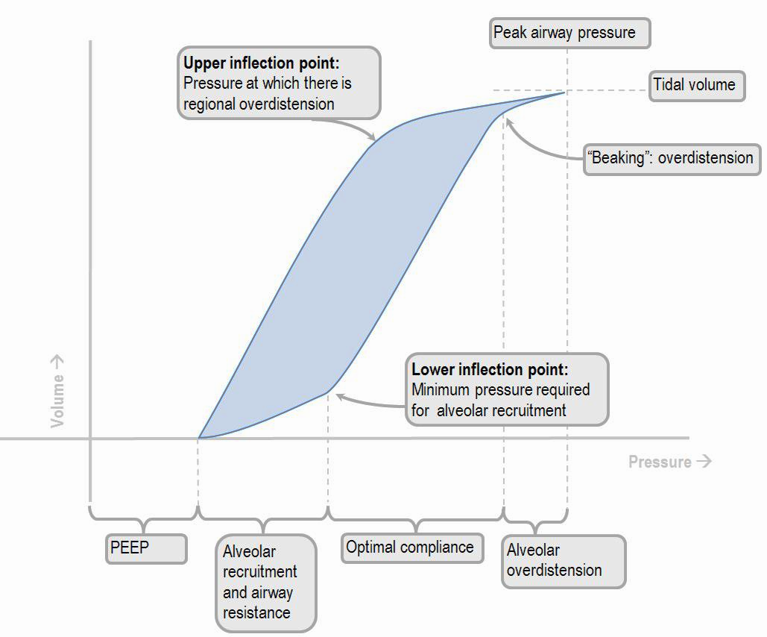
Driving Pressure
Definition: Driving Pressure (ΔP_{aw}) = Pplat – PEEP
Pressure from end-inspiration through end-expiration
Difference between lung “full” (with no air flow) and lung “empty” with no air flow
Surrogate for the compliance (or elastance) of the respiratory system (NOT the lungs only)
*assume no auto PEEP

Slide 24
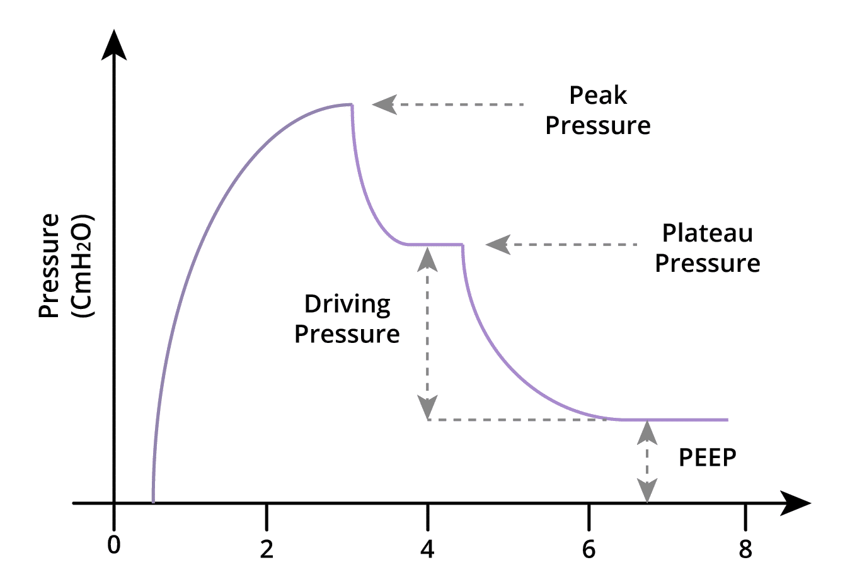
Driving Pressure and the meaning of PEEP
DEFINITION: Driving Pressure = Pplat – PEEP.

Slide 25
Driving pressure and meaning of PEEP
In a high compliance (low elastance) respiratory system…
↑PEEP → ↓P_{plat}
PEEP opens (or prevents closure of) alveoli.
Driving pressure goes down
PEEP is only protective if it improves aerated lung volume or compliance which is measured as ΔP_{aw}
In a low compliance (or high elastance) respiratory system:
↑ PEEP → ↑Pplat
The pressure generated from increased PEEP will simply be transmitted to the P_{plat .}
There is no change in driving pressure

Slide 26
Trans-pulmonary pressure

Slide 27
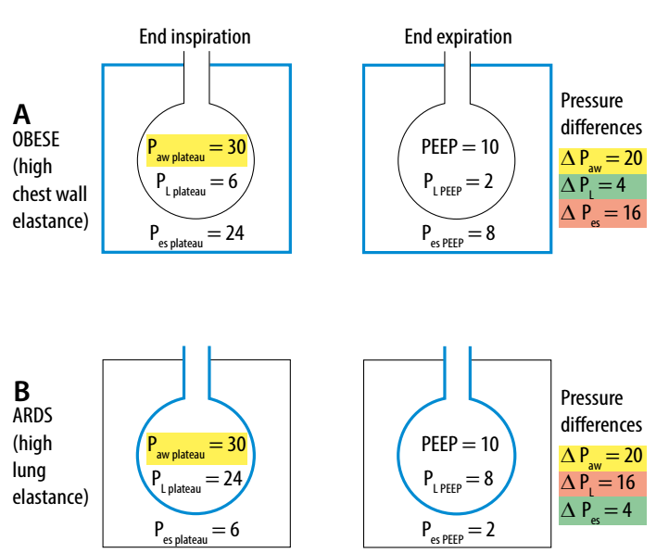
Setting PEEP and transpulmonary pressure
Consider cause of atelectasis (hypoxemia)…
Poor lung compliance elevated PEEP can be harmful.
Poor respiratory system compliance (but normal lung compliance), elevated PEEP can be protective.
What to do?
Up titrate PEEP until ΔP_{aw} doesn’t get better.

Slide 28
In the real world…
Transpulmonary pressure is nearly impossible to measure in the operating room. It requires an esophageal balloon manometry which is hard to use.
You can titrate Vt and PEEP to optimize ΔPaw. In some patients, higher PEEP will not contribute to ventilator associated lung injury (e.g. obese, abdominal insufflation, Trendelenberg). In others it will (e.g. pulm edema, ARDS, pneumonia, interstitial lung disease.
You have to adjust your settings to each patient’s risk of ventilater induced lung injury (VILI).

